Slide 1

Web App/API Security
WEBD 5201 WEB DEVELOPMENT FRAMEWORKS

Slide 2

Web App Security
Web application security refers to the measures and practices implemented to protect web applications from various security threats, vulnerabilities, and attacks. Web applications are software applications that users access through web browsers over the internet.
Security is a crucial aspect of web application development and maintenance to ensure the confidentiality, integrity, and availability of the application and its data.

Slide 3
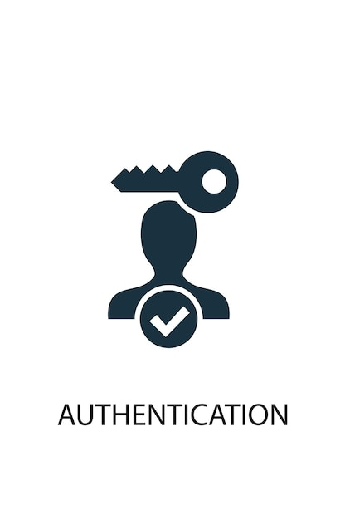
Authentication and Authorization
Authentication: Ensures that users are who they claim to be. Standard authentication methods include username/password, multi-factor authentication (MFA), and biometrics.
Authorization: Controls what actions authenticated users are allowed to perform within the application. Role-based access control (RBAC) is a common authorization mechanism.

Slide 4
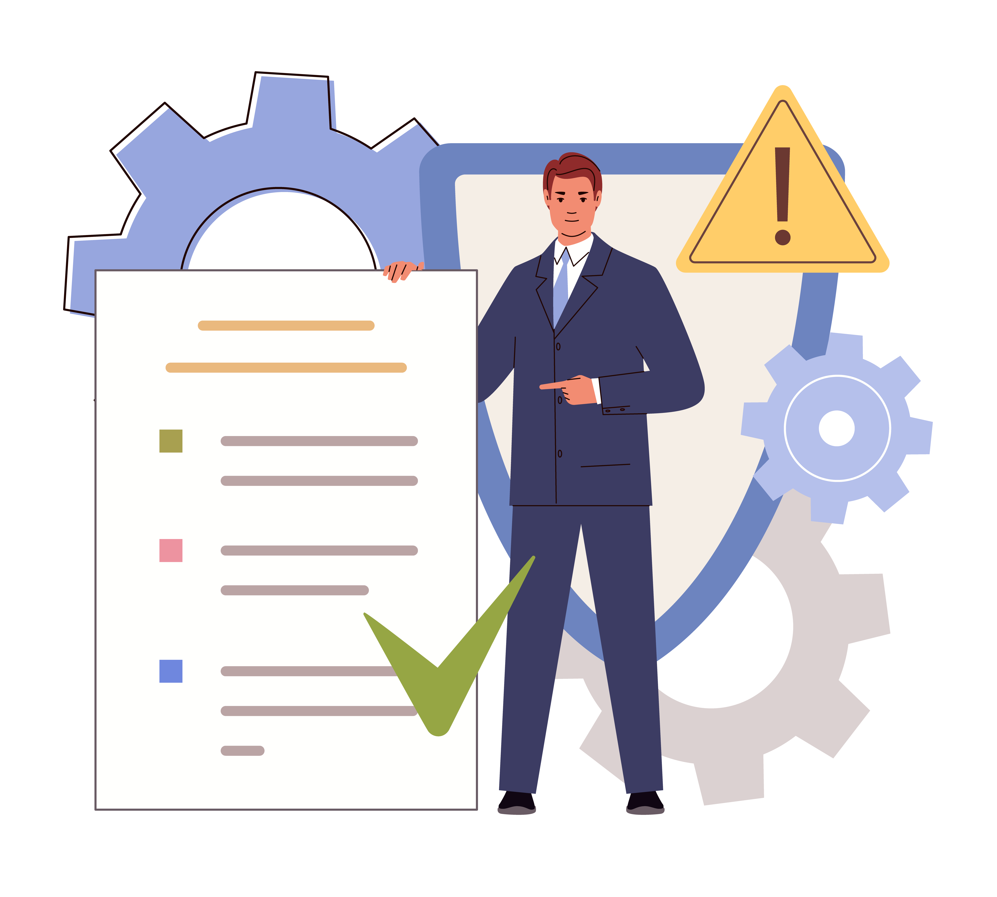
Input Validation
SQL injection
Cross-Site Scripting (XSS) - Prevents attackers from injecting malicious scripts into web pages that other users view. This is often done through input validation and output encoding.
Cross-Site Request Forgery (CSRF) - Protects against CSRF attacks by using anti-CSRF tokens, ensuring that requests made to the server are legitimate

Slide 5

Secure Communication
Manages user sessions securely, including session timeouts, secure session storage, and secure session identifiers. Regenerating session identifiers after login helps mitigate session fixation attacks.

Slide 6

File Upload Security
Safely handles file uploads by validating file types, setting file size limits, and storing uploaded files in secure locations.

Slide 7
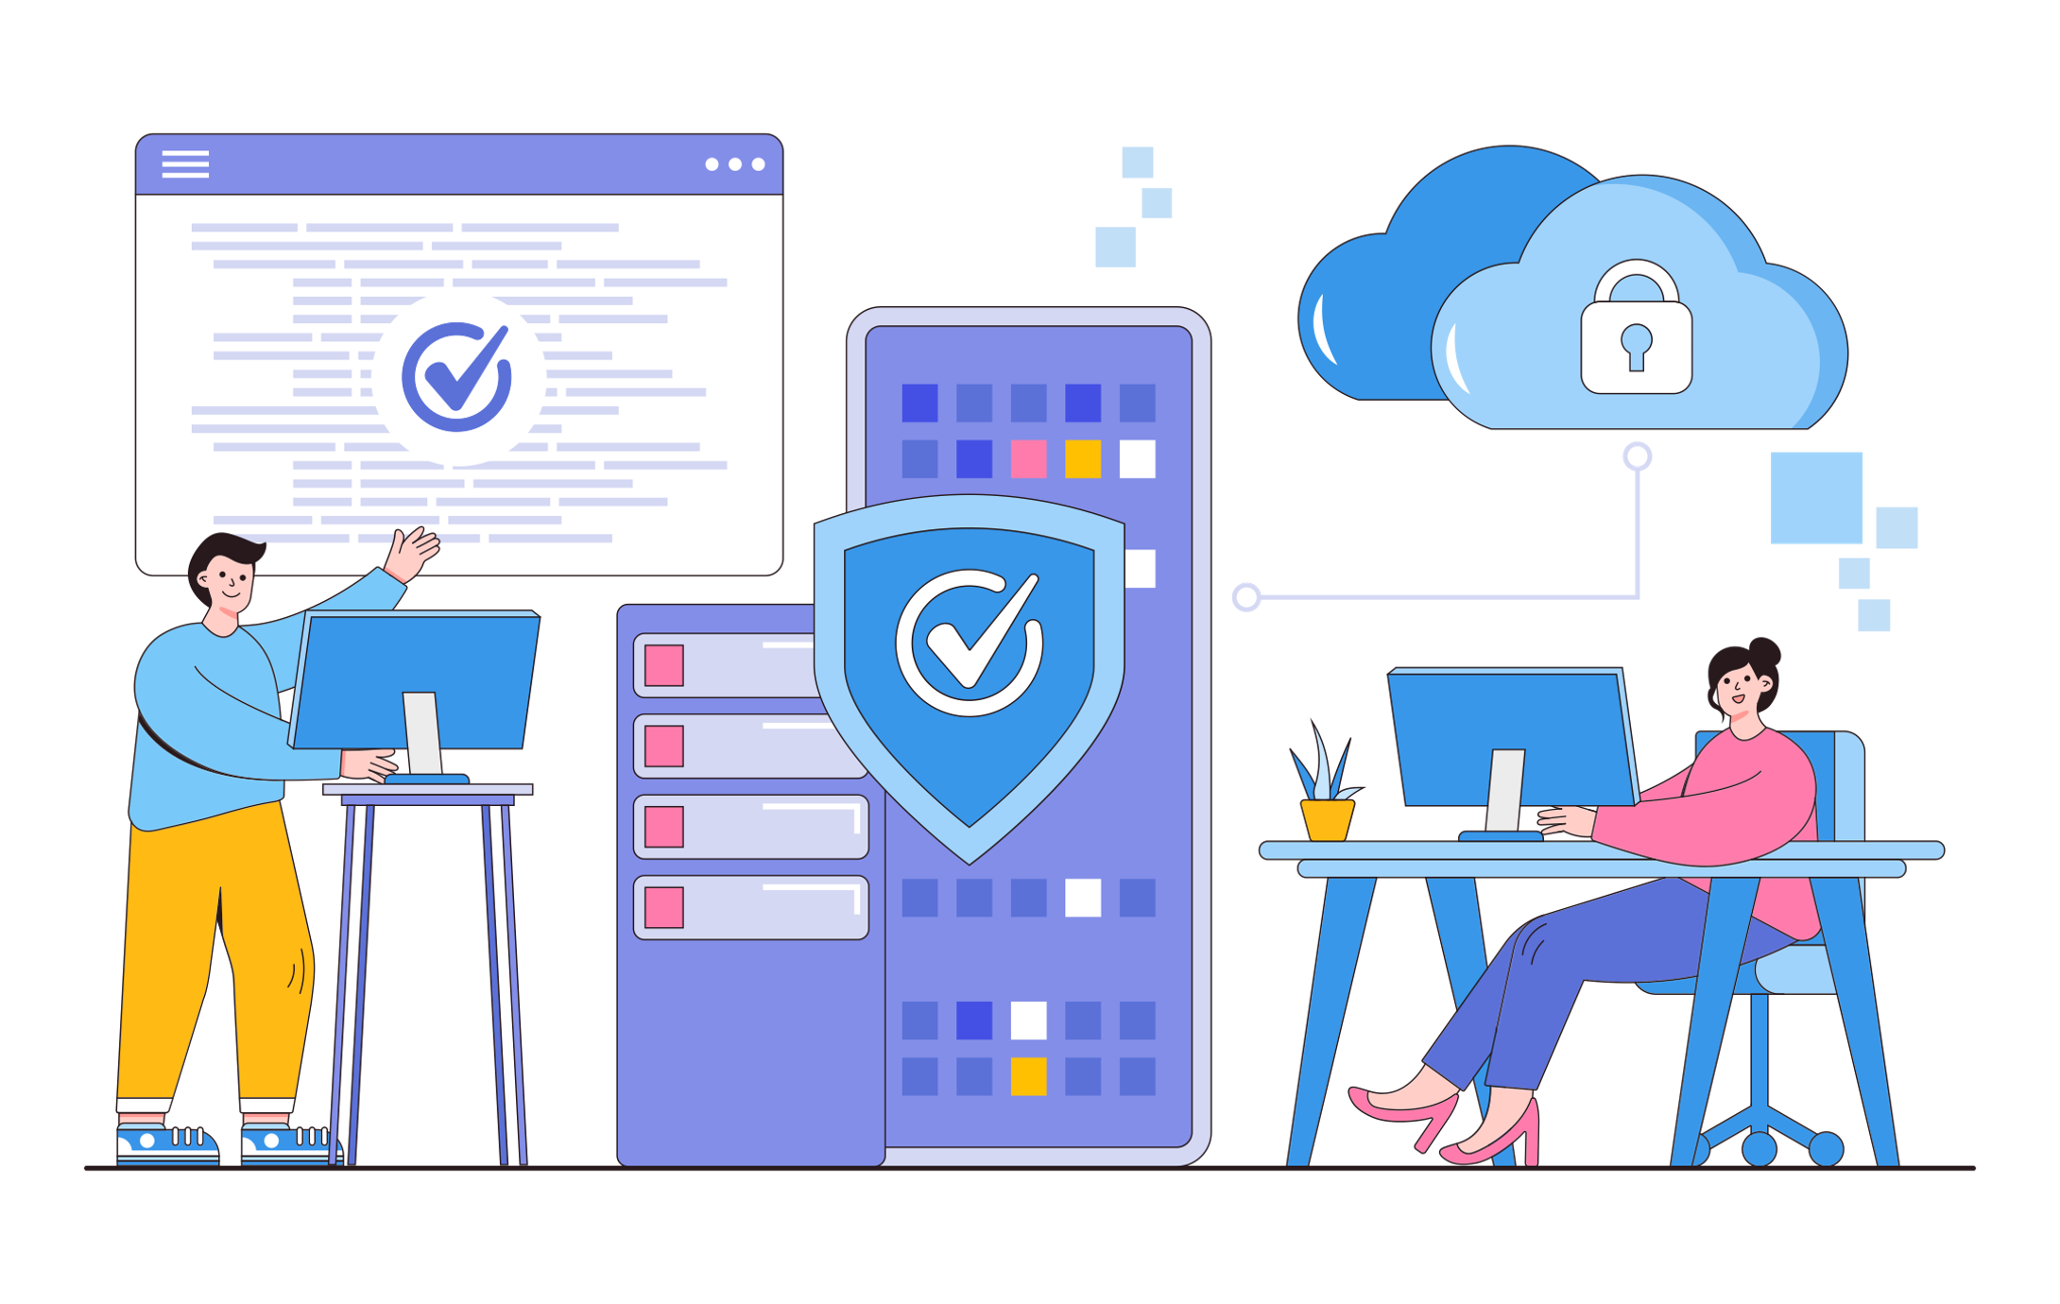
Security Audits and Penetration Testing
Conducts regular security audits and penetration testing to identify and address vulnerabilities.
Implements comprehensive logging to track user activities and detect suspicious behaviour. Sets up monitoring and alerts for security events.

Slide 8
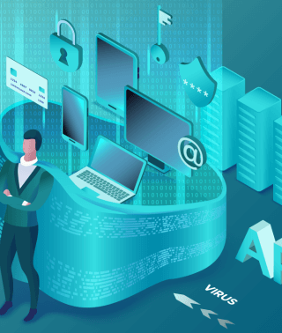
API Security
Securing an API (Application Programming Interface) is crucial to protect sensitive data, prevent unauthorized access, and ensure the integrity of your application.

Slide 9
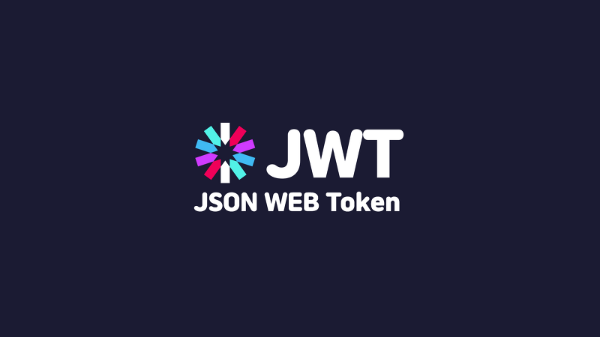
Token Validation
If using tokens for authentication (e.g., JWT), validate and verify tokens on the server side.
Check token expiration, issuer, and signature to ensure their authenticity.

Slide 10

Rate Limiting
Implement rate limiting to prevent abuse or unauthorized access by limiting the number of requests a user or IP address can make in a given time period.

Slide 11
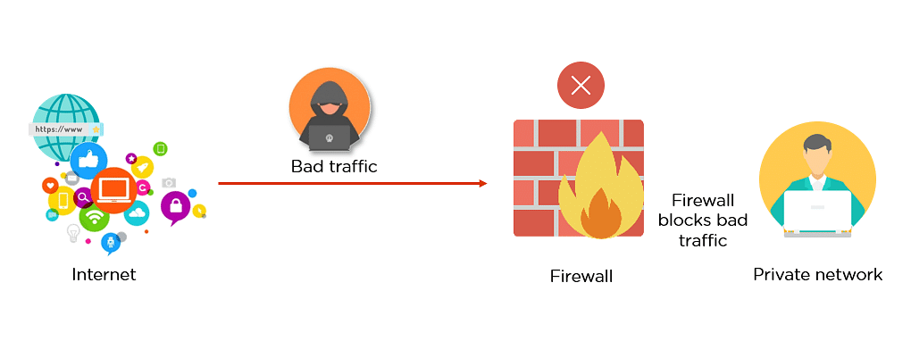
Firewall
Use firewalls to protect your API infrastructure and monitor network traffic for suspicious activity.

Slide 12
Tutorial
https://github.com/spkdroid/SpringMVC-Security/tree/master

